Slide 1
OOP Final
Juan Guerra
Adolfo Gonzalez
Jered Gallegos

Slide 2

We Created BreakOut/Brick Breaker or whatever you know the game by

Slide 3
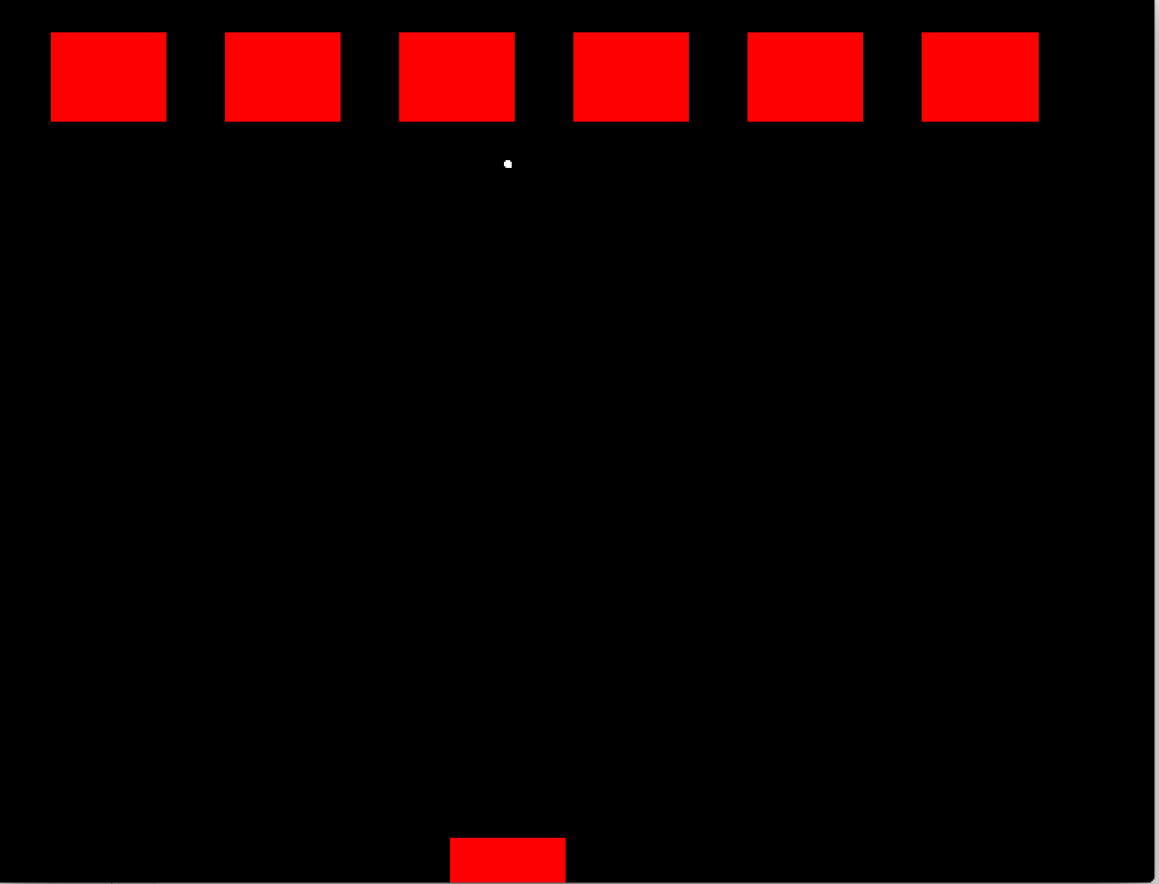
Game Structure
Objects: Bricks, Paddle, and a Ball
Purpose: Break the bricks with the ball; prevent the ball from hitting the floor with the paddle
Details: Angles, speed, appearance
20XX | 20XX | 20XX | 20XX

Slide 4

Implementation
Jered: Create the objects and movement
Juan: Create game logic
Adolfo: Combined components into final product

Slide 5
Objects
Paddle - Simple Rect object that takes in _markx in draw function to move left and right only.
Block - extends directly from Rect object to obtain draw and contain functionality. Contain function constantly being called in the idle function to know where the ball is at all times.
Ball - a simple vector point that is being incremented in both the x and y directions based on what it was been in contact with last.

Slide 6
Logic
Levels- After destroying all six blocks, you will move on to the next level
Speed increase
Brick color changes
Lives- Three lives are given to the player
Player loses a life if the ball hits the floor
After all lives are lost, game resets

Slide 7
Combination
Removal- Made sure the bricks would react as they should.
Angles- Made ball have the correct vector values.
Test- Paddle can go offscreen for a testing cheat.

Slide 8

Results:
It works!
The bricks break, the ball moves on its own, the player controls the paddle

Slide 9
Lessons Learned
Don’t take games for granted
Even what you think might be simple games require you to analyze each game situation and scenario that might occur.
Scheduled meetings help with brainstorming
Start early!

